Slide 1
Laser Induction
Version: 9
Last updated: 28 Feb 2023
Ruby version: 2.3.1.24878
This presentation is available on the Laser PC in Desktop / Laser induction

Slide 2
Agenda
Personal intros, experiences and expectations
Intro to the laser
Health & Safety
Machine maintenance
Access to the space and machine booking
Materials shop
Workflow
Knowledge gaps and next steps
Register account on Ruby

Slide 3
Intro to the laser
Laser, mirrors, lens, gantry, bed (movable), rotary attachment
Cut and engrave through vaporisation of materials (and mark metal)
Result is a combination of material, laser power and speed and the properties of the design
CO2 laser capabilities
Master resource: Tools page

Slide 4
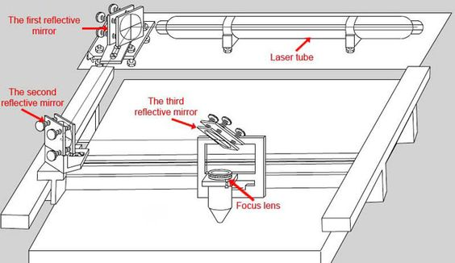
Laser, mirrors, lens, gantry, bed
Gantry
Bed
Our laser is oriented the other way around (first and second mirror on the right), but the principle is the same.

Slide 5
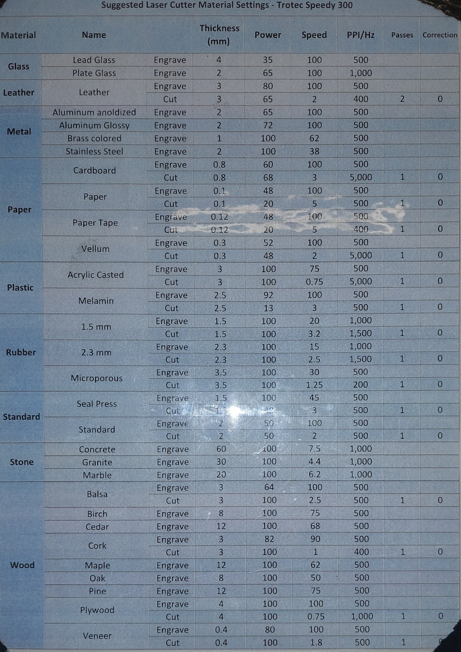
CO2 laser capabilities
Cut & engrave results depend on:
Material (its reaction to laser light)
Power
Speed
DPI (engraving?) / Frequency
Passes (repeat cuts)
Condition of the machine
Age of laser tube
Size of bed

Slide 6
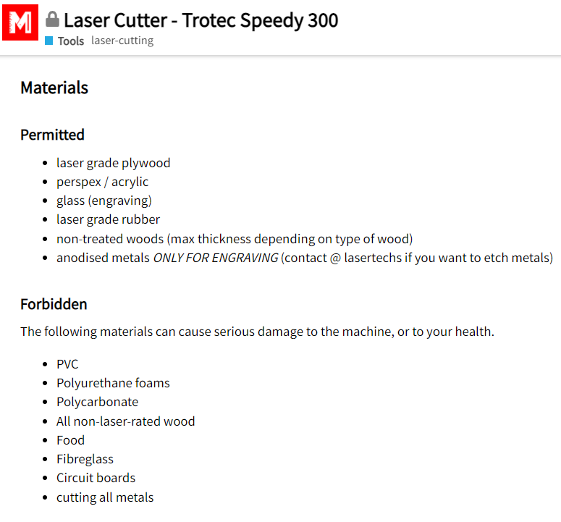
Health & Safety
No unattended use
Danger of death - permitted materials only
Do not override the safety mechanisms
Do not use if you haven’t been inducted
✓
✗

Slide 7
Machine maintenance
The laser machine is generally in really good working order
This is due to maintenance before and after each use, and regular maintenance by the lasertechs
A dirty machine performs sub optimally
Accumulated dirt can cause corrosion and other damage
Please report problems on discourse and tag @lasertechs

Slide 8
High-level workflow
1. Preparation
Files / Materials / Booking
2. Startup
Cleaning, safety review
Power, material placement and focus
3. Run job
Ruby: Manage > Design > Prepare > Produce
4. Cleanup and shut down

Slide 9
❶ Preparation
Doesn’t have to be done in the Makerspace
2D file in the appropriate format
Adobe Illustrator, Inkscape (cut and vector engrave)
JPG and other formats (engrave)
Materials
Purchase material – must be laser-safe
Shop stock – stock levels not guaranteed

Slide 10
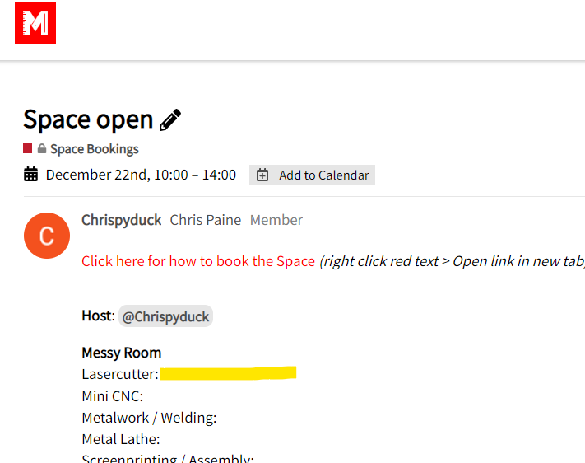
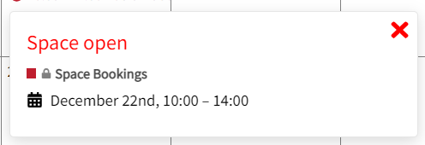
❶ Preparation
Book a session
Host vs non-host
Procedure
Make sure you have your Ruby password!

Slide 11
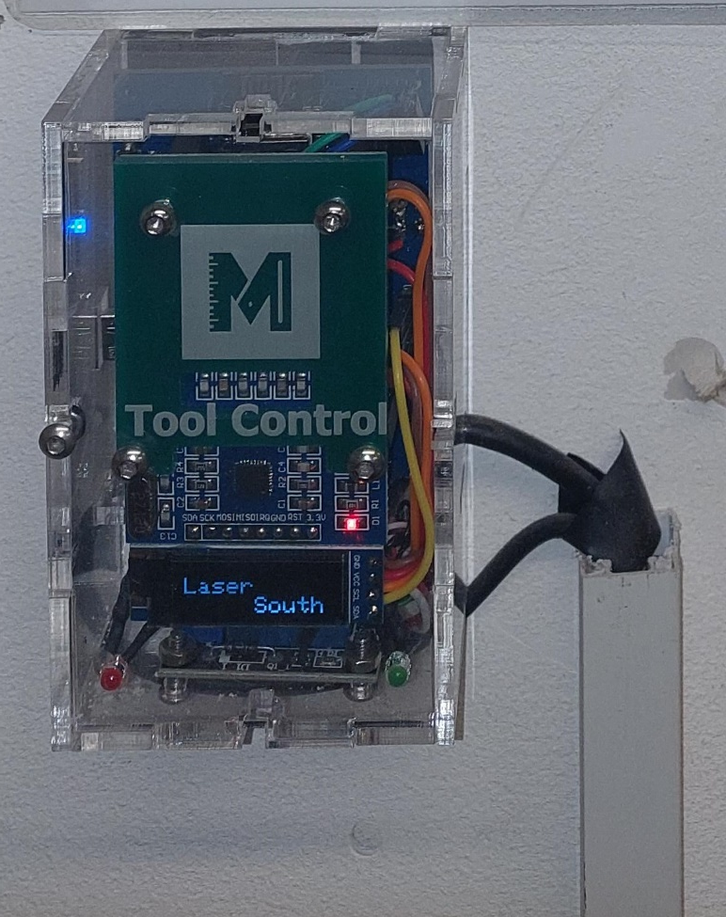
❷ Startup
Power
Laser PC on
Tap tool control with fob
Laser on
Wait for warmup and homing

Slide 12
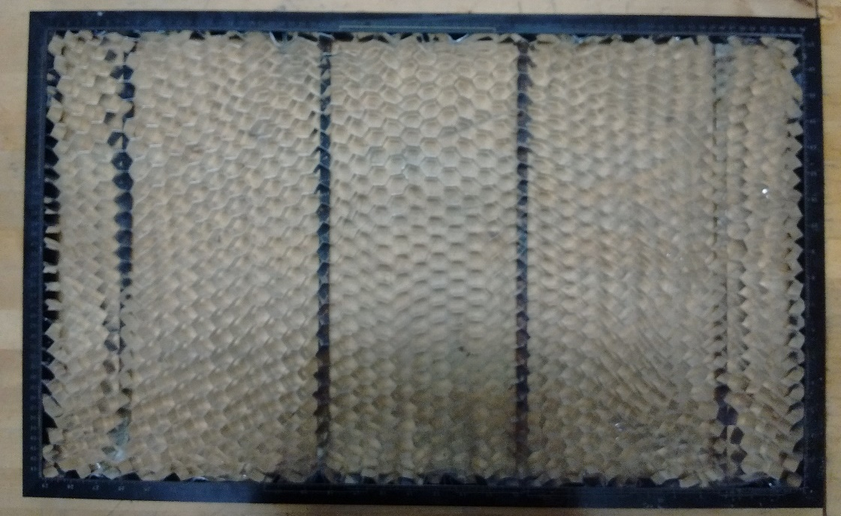
❷ Startup
Honeycomb bed
Clear out any bits left on the bed (brush / remove and vacuum)
Make sure it is firmly seated on rails

Slide 13
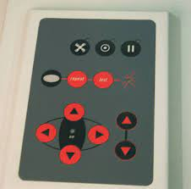
❷ Startup
Prepare to clean
Move the bed to a comfortable height
Move the head to a comfortable position
Place a blue paper towel sheet and cleaning supplies on the bed

Slide 14
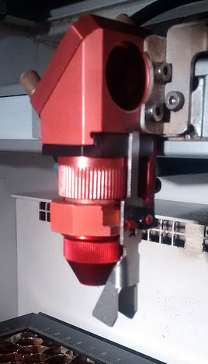
❷ Startup
Nozzle
Inspect:
Unscrew – clockwise when seen from above
A dirty nozzle is a good indication that other parts will need cleaning
If dirty:
Use spray foam and a cotton bud
Replace finger-tight
Tip: Turn the laser on and move it to a convenient
location for accessing the head. You can also lower
bed if that helps.

Slide 15
❷ Startup
3rd mirror
Inspect:
Hold mirror in one hand, unscrew thumbscrews with the other
Carefully lift mirror and inspect it for dirt
If dirty:
Note orientation when removing
Puff, douse with lens cleaning fluid, dab with lens tissue
Return and tighten screws quite tightly

Slide 16
❷ Startup
Lens
Inspect:
Hold lens tray in one hand, unscrew with the other – clockwise when seen from above
Slide lens out
Hold lens to the light and inspect it for dirt (scratches and burnt spot are OK)
If dirty:
Puff, douse one side with lens cleaning fluid, wait 30 seconds, dab with lens tissue (using each part of the tissue only once)
Repeat on the other side
Return and tighten finger-tight
If the lens is milky, do not use. Report to @lasertechs

Slide 17
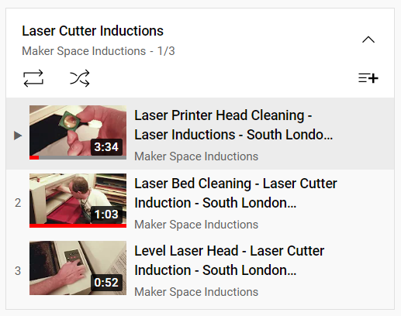
Watch videos

Slide 18
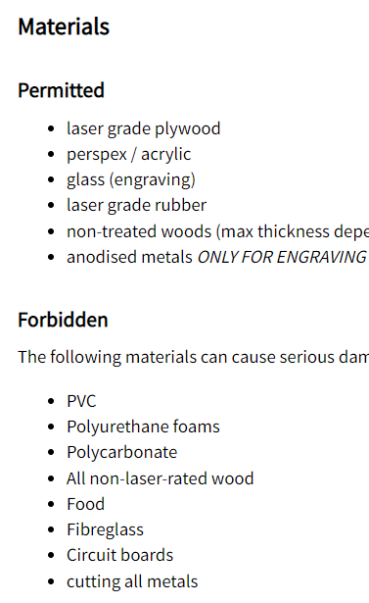
❷ Startup
Safety
Are you using laser-safe material (see Tool page)?
Is there a CO2 fire extinguisher nearby?
Note the Emergency Stop button

Slide 19
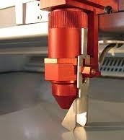
❷ Startup
Material placement and focus
Place within comfortable reach (you’ll need to be able check that the material is square on the bed)
Double buttons to raise and autofocus bed
Roughly position head over material
Use the focus stick to fine-tune the focus

Slide 20
❸ Run job
Open Ruby from the Start Menu
Login to Ruby
Manage – access previous designs and jobs
Design – import a new design
Prepare – apply specific laser settings
Produce – cut and engrave
A brief intro to Ruby follows…

Slide 21
Intro to Ruby
Ruby is a Laser Control Software specific to Trotec lasers
It is approximately equivalent to LightBurn, RDWorks, etc
It is a replacement for JobControl
You do everything (except the design) in Ruby
Each user needs a login to access Ruby
The software is web based (runs in the browser)
“Designs” are files
“Jobs” are designs + cut and engrave settings (repeat work)

Slide 22
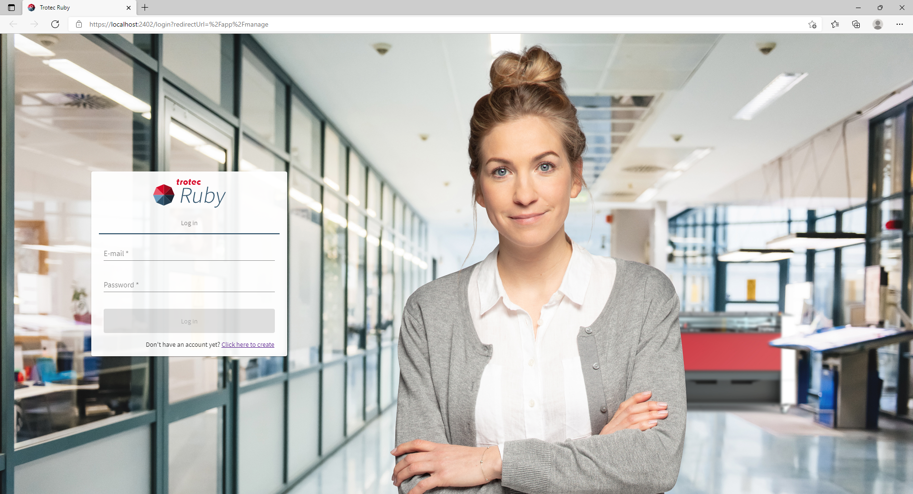
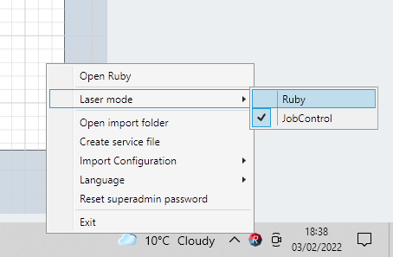
1. Get started

Slide 23
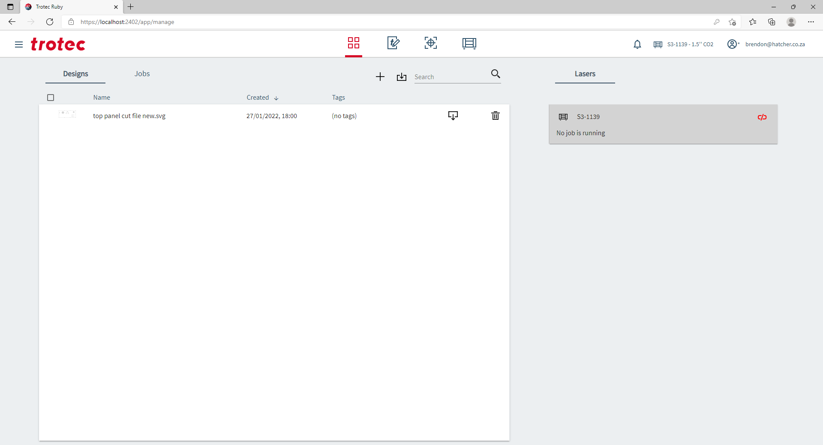
2. Manage
View your previous designs and jobs

Slide 24
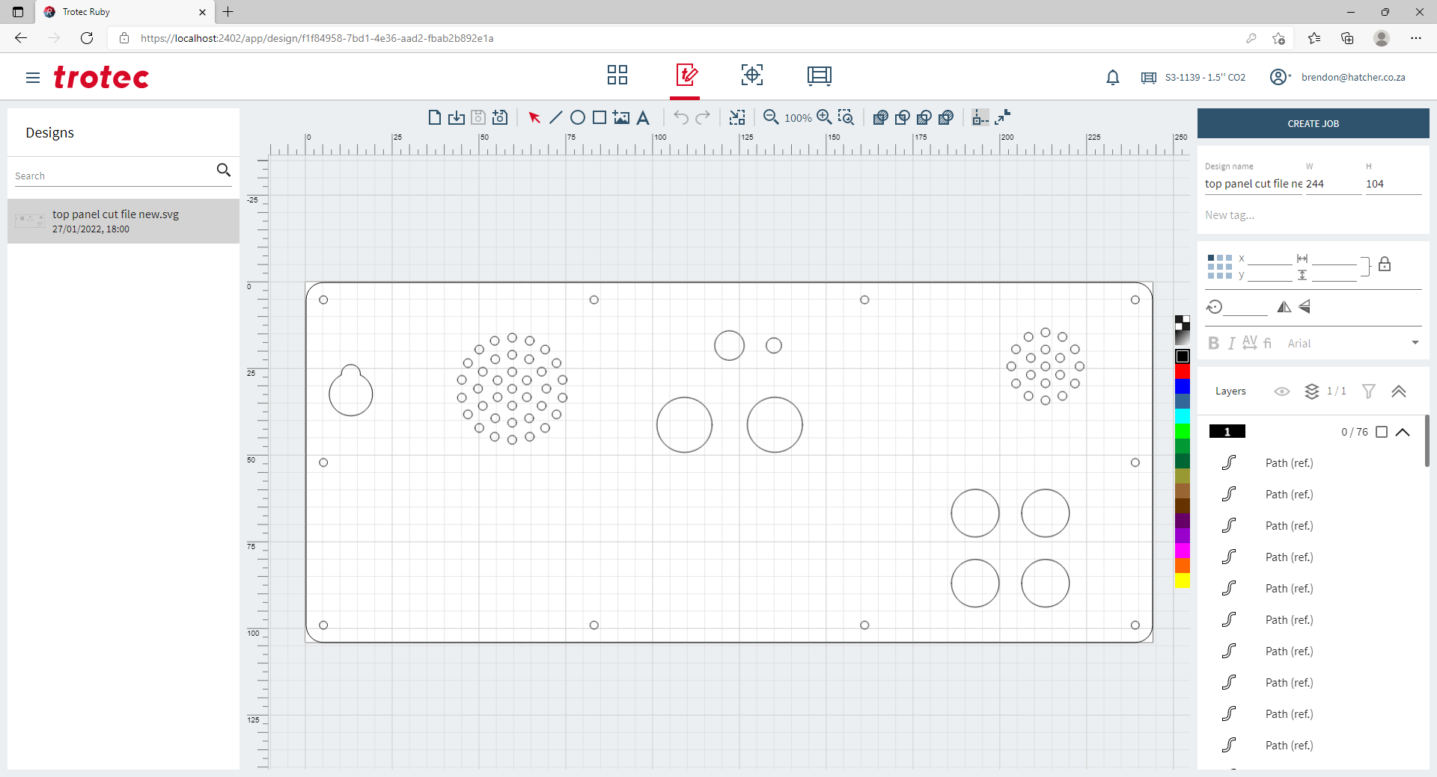
3. Design
Don’t bother to design here – the tools are rudimentary
Just import your files

Slide 25
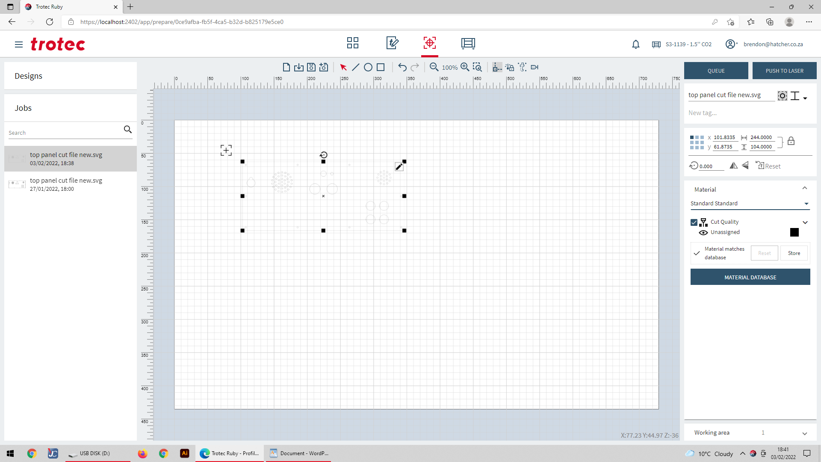
4. Prepare
Position it on the bed
Set the material and output settings
Set/tweak the colours to determine which output settings apply to each object

Slide 26
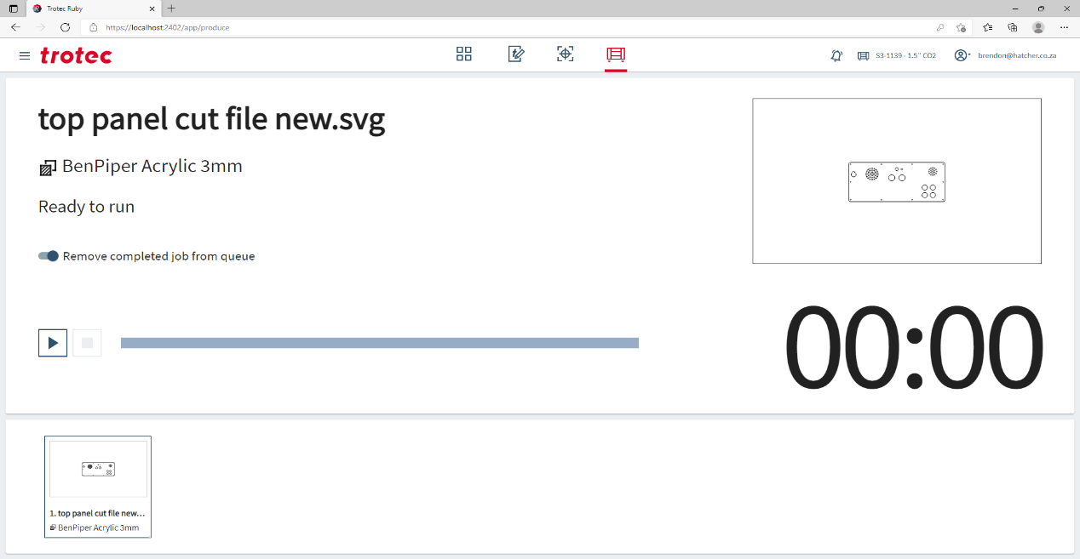
5. Produce
Cut and engrave
Wait before opening the lid to let smoke clear
Hold material so it doesn’t move
Tap pieces to make sure that they are cut through

Slide 27
❹ Cleanup and shut down
Remove any debris from the bed
Check (and clean) the nozzle, mirror, lens
Shut down the laser
Logout of Ruby
Shut down the PC
Sign out of the tool control
Clear junk bits
Place usable offcuts in the scrap bin

Slide 28
Ruby “remote” access
Use this to learn, or to set up your job
You must be at the Makerspace!
Login to the Makerspace wifi
Go to https://slms-05.local:2402/
You can do everything except start the laser!
Go to the laser PC and login to start the job
Note: You can only be logged in one PC at a time

Slide 29
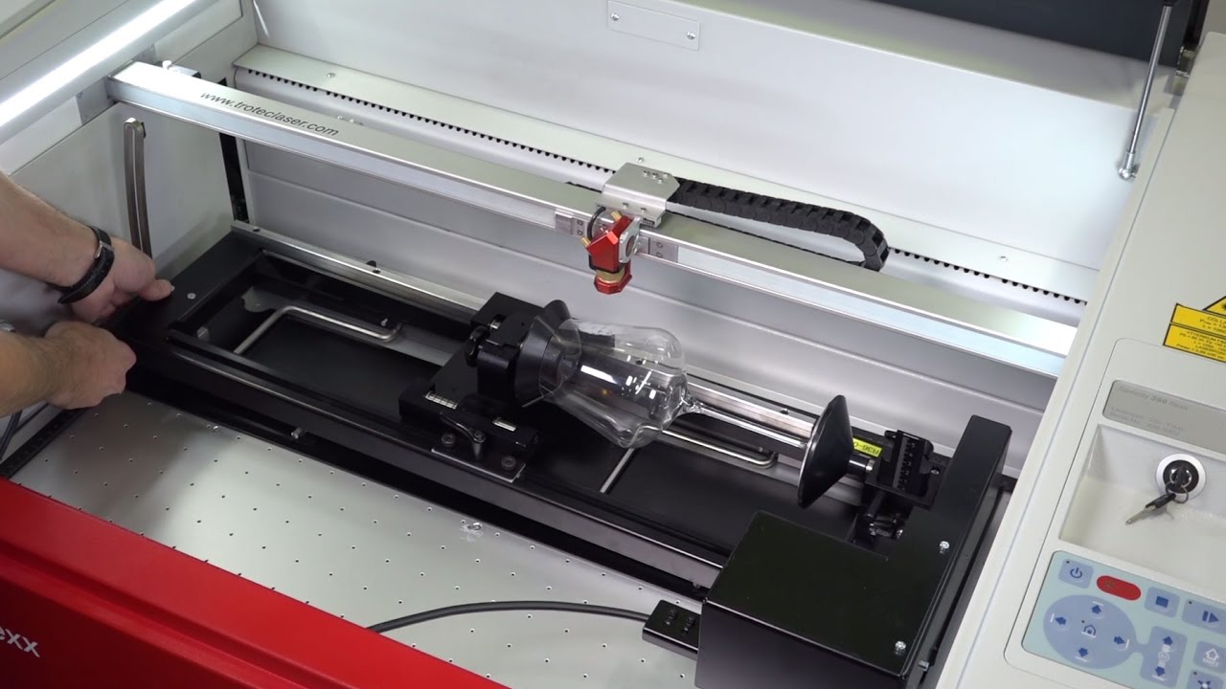
Rotary attachment

Slide 30
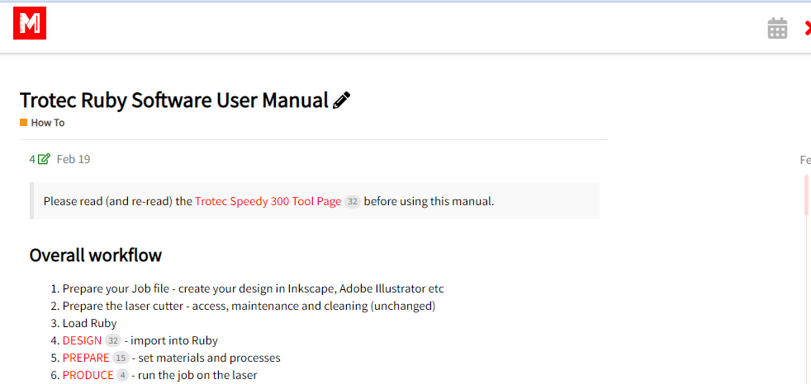
Help
Trotec manuals - https://www.rubyhelp.com/
SLMS wiki – loads more detail than in this presentation

Slide 31
Knowledge gaps and next steps
2D design
Understanding materials and their interactions with the laser
Advanced techniques
Job optimisation
Workshops and “project days”
First project

Slide 32
Resources to explore
Brendon’s book
https://lasercuttingfundamentals.info/
Vecteezy – vector stock images (not all laser-friendly)
https://www.vecteezy.com/
Box generator – parametric, lots of designs
https://www.festi.info/boxes.py/
Laser-ready designs – download and cut!
https://designbundles.net/craft/laser-cutting-designs
https://www.librarylaser.com/en/

Slide 33
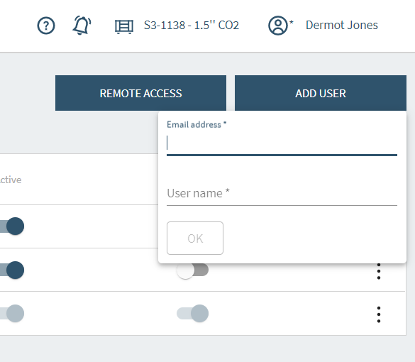
Ruby registration
Lasertechs, follow the instructions here
(Look for the heading - 6. User administration)
Each user needs a username associated with an email address and a password.
There is no “forgot password” feature.
If you forget your password, contact the lasertechs on discourse.

